Slide 1

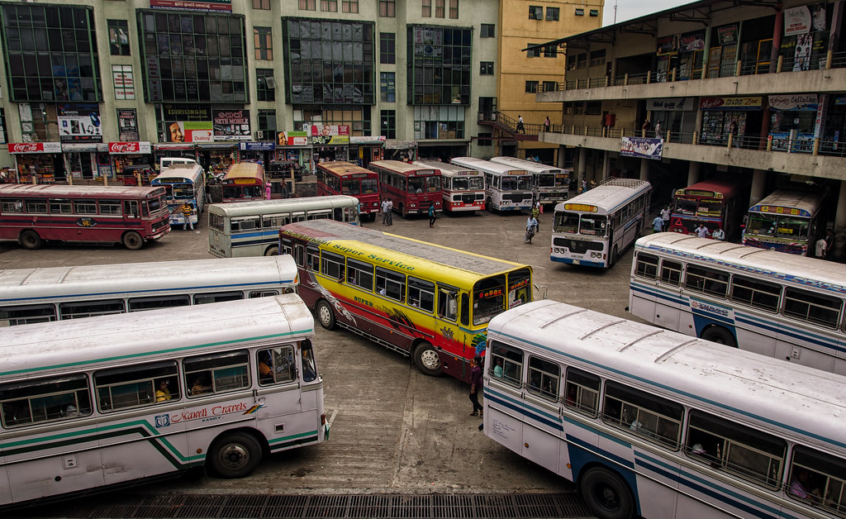
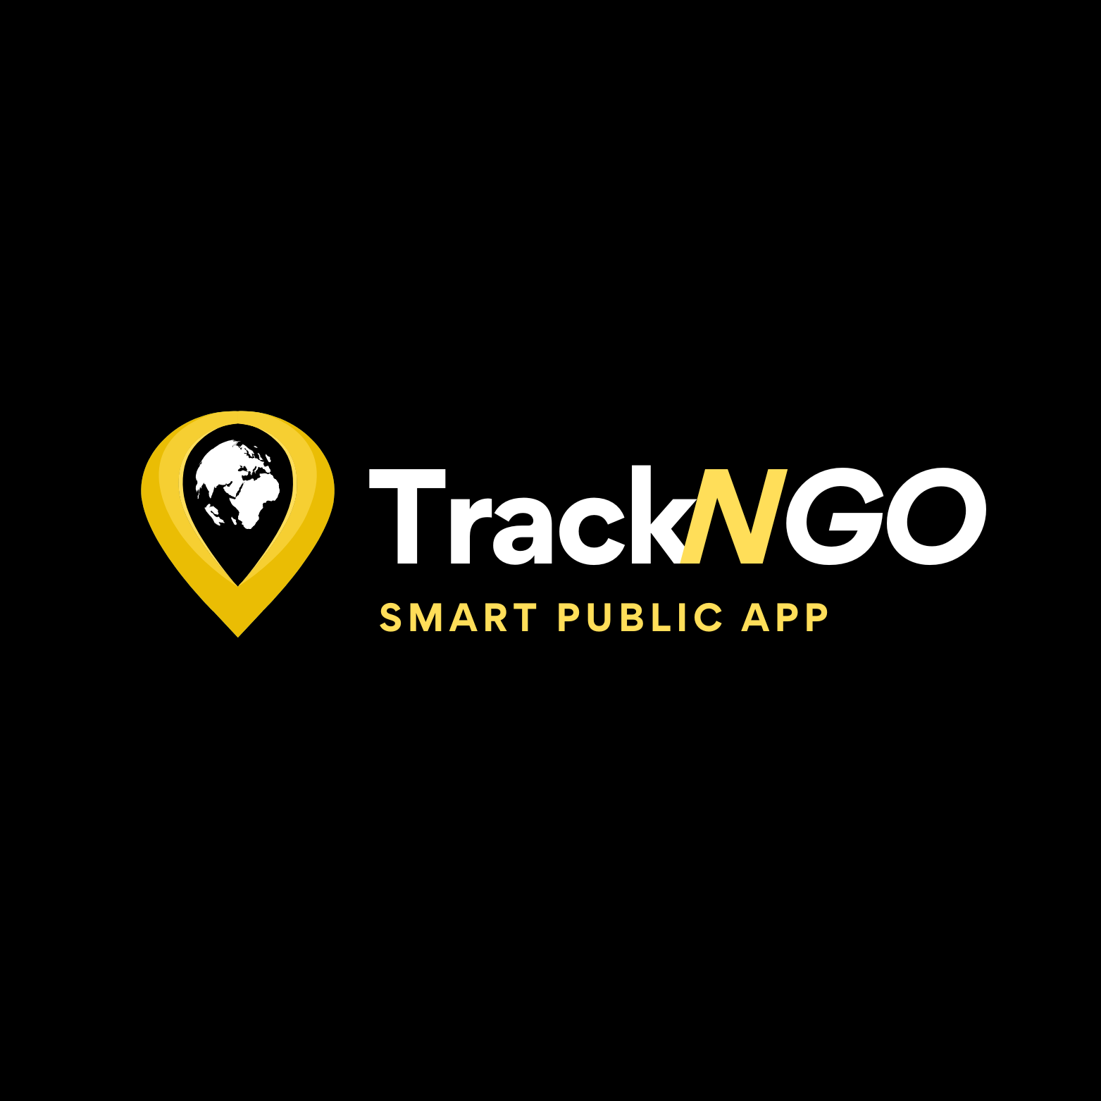
GROUP 08
SMART PUBLIC TRANSPORT APP
Notes:
Hello everyone, we are Group 08, and today, we’re excited to present our project, TrackNGo, a smart public transport app designed to improve commuting for the people of Sri Lanka.
I’m [Your Name], and along with my teammates [List team members], we’ve working hard in bringing this idea to life

Slide 2
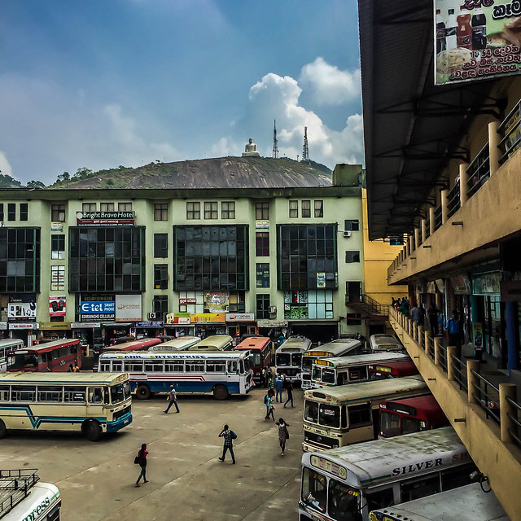
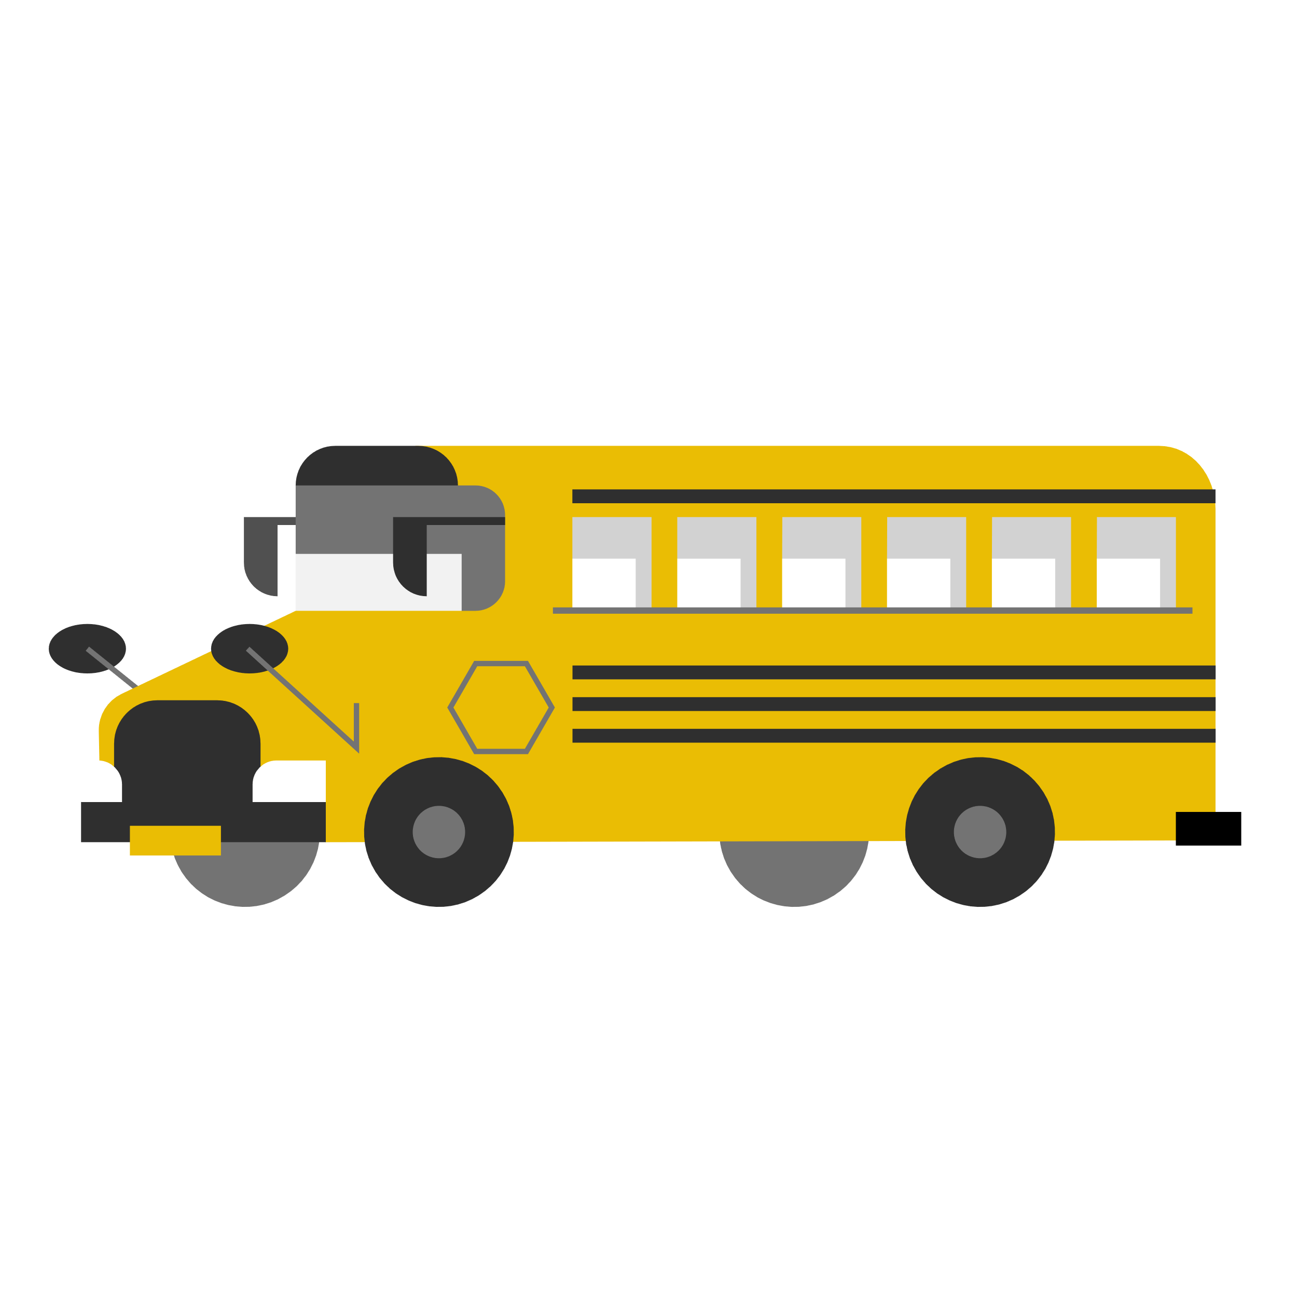
Introduction
Public transportation is vital for urban life, but Sri Lanka’s bus system struggles with long wait times, outdated schedules, and inefficient routes, frustrating commuters. The TrackNGo web app addresses these issues with GPS tracking and real-time route planning, allowing users to view live bus locations, plan routes, receive notifications, and report lost items enhancing the commuting experience.
Notes:
Let’s start by looking at why this app is important. Public transportation is essential for cities, but Sri Lanka’s bus system faces major issues.
Commuters often experience long wait times, deal with outdated schedules, and take inefficient routes. These issues make commuting stressful and unreliable

Slide 3
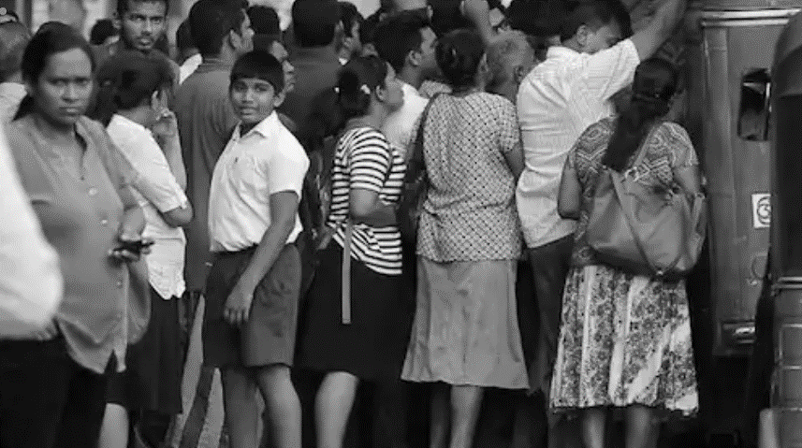
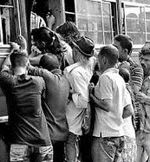
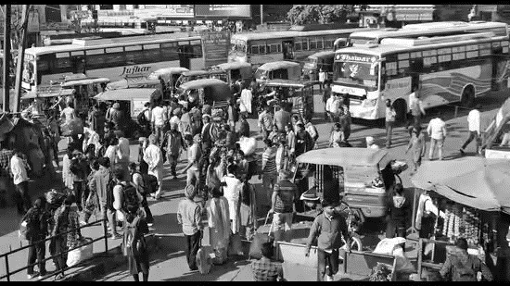
Problem Statement
Challenges in Sri Lanka's Bus System:
Extended wait times.
Outdated schedules.
Poor route optimization.
Issues: Lack of real-time updates and route planning.
Need: A tech-driven solution to enhance accessibility, efficiency, and reliability in public transport.
Notes:
We identified a few key challenges in Sri Lanka’s current bus system.
First, there’s extended waiting time at bus stops. Buses don’t always run on time, and delays are common.
Second, schedules aren’t updated frequently, leaving commuters with outdated information.
Third, routes are not well-optimized, which often leads to inefficient, time-consuming journeys.

Slide 4
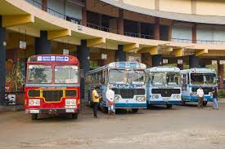
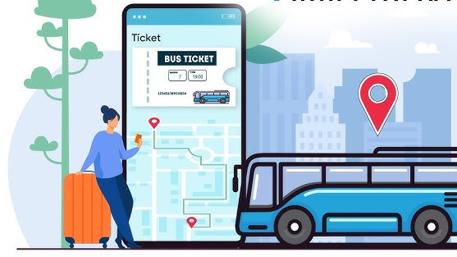
Project Objective
To develop a smart bus transportation app that improves commuting in Sri Lanka and Make public transit more accessible, reliable, and efficient, helping users plan journeys with ease.
Notes:
Our project objective is clear: we want to make commuting in Sri Lanka easier.
TrackNGo will improve the accessibility, reliability, and efficiency of public transport.
We believe that if people can see where their bus is, plan their route better, and receive real-time notifications, they’ll feel more in control of their journey, making the whole process much more convenient.

Slide 5
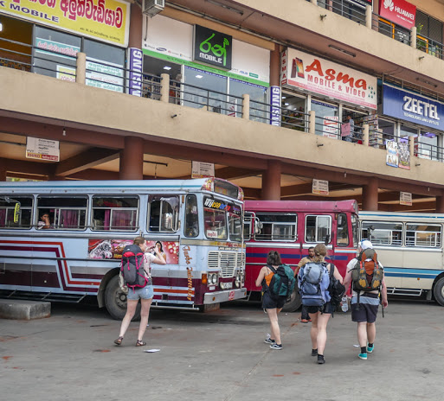

Proposed Solution
Real-Time Tracking: Live bus locations to reduce wait times.
Updated Schedules: Access the latest bus schedules anytime.
Notifications: Alerts for arrivals, delays, and disruptions.
Lost & Found: Report and track lost items easily.
Fare Calculation: Automatic fare estimates based on route.
News & Insights: Transport info plus relevant news updates.
Notes:
Here’s what TrackNGo offers:
Real-Time Tracking – Commuters can view live bus locations, reducing the time they spend waiting.
Updated Schedules – We provide access to the latest bus schedules.
Notifications – Alerts about arrival times, delays, or disruptions.
Lost & Found – A feature where users can report and track lost items.
Fare Calculation – Automatic estimates based on the chosen route.
News & Insights – Relevant transport updates and news

Slide 6

Target Users
Primary Users: Urban Commuters in Sri Lanka, including:
Students
Workers
Tourists
Notes:
Our target audience includes urban commuters in Sri Lanka: students like us,
who rely on public transport daily; workers, who need reliable options to get to work; and tourists, who often face challenges with unfamiliar routes.
By focusing on these groups, we hope to address the needs of a large portion of the population.

Slide 7
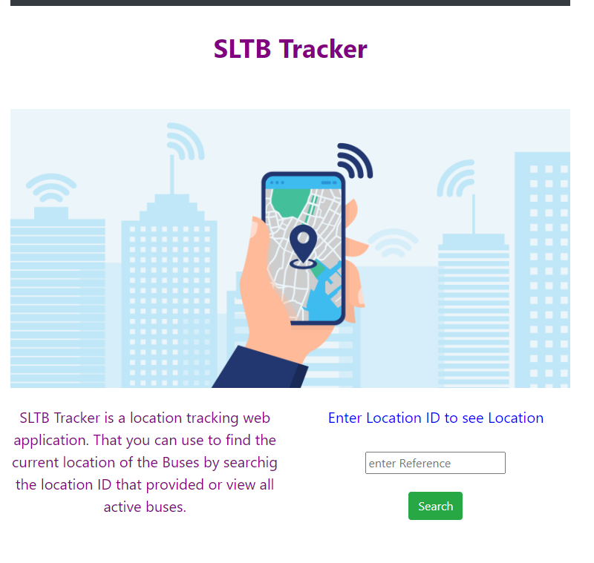
Existing Systems
SLTB Bus Tracker
Tracking Feature not Functioning
Limited Features
Low User Satisfaction
Lack of user Friendly features
Notes:
We also looked at other systems, like the SLTB Bus Tracker.
It has a basic tracking feature, but it doesn’t function reliably.
It has limited features and doesn’t cater well to user needs.
Most users find it difficult to use and limited in terms of what it can do.

Slide 8
Why TrackNGo is Different
Real-time Updates: Accurate bus locations and arrival times.
Lost & Found: Simple item reporting and recovery.
Future-Ready: Expanding to trains, taxis, digital payments.
Notes:
What makes TrackNGo different?
First, our real-time updates are accurate, providing users with bus locations and estimated arrival times.
We’ve also simplified the lost-and-found feature, making it easy to report and retrieve items.
And we’re designing TrackNGo to be future-ready, with potential expansions for trains, taxis, and even digital payment options.

Slide 9
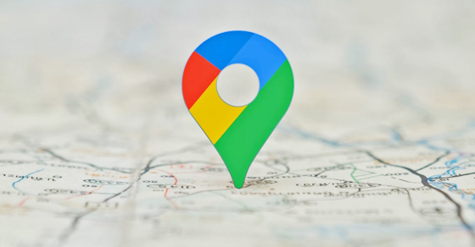


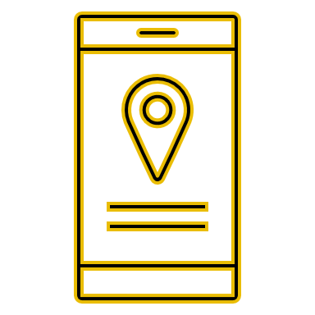
Functional Requirement
Real-Time Bus Tracking
Route Information
Bus Schedules and Estimated Times
Fare Estimation
Notifications and Alerts
Lost Item Reporting
Feedback and Ratings
Notes:
For the app to work smoothly, we identified some key functional requirements.
These include GPS tracking, notifications, route planning, and fare estimation.
Each function has to be tested to ensure it meets user expectations and addresses the challenges we highlighted

Slide 10

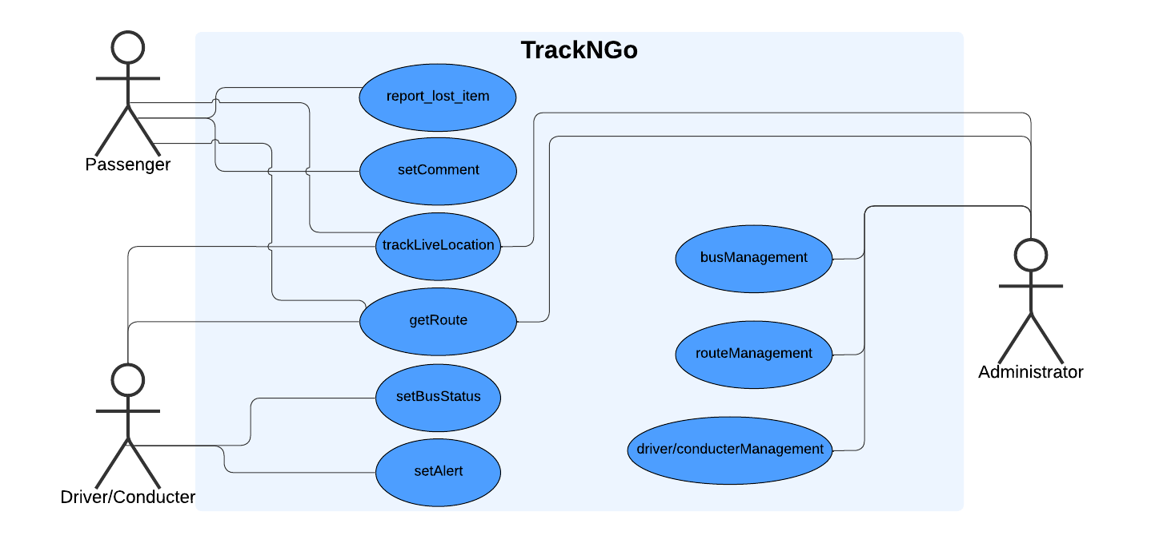
Use case Diagram
Notes:
Here, we have the use case diagram. It illustrates how the app interacts with users in various scenarios.
For example, a user can check real-time bus locations, report a lost item, or receive notifications.
This diagram helped us structure our app’s functionality to cover all essential user interactions

Slide 11
Non-Functional Requirement
Performance
Security
Scalability
Notes:
Besides functional requirements, non-functional requirements are also important.
These include performance, reliability, and user-friendliness.
For example, the app needs to load bus locations quickly and send notifications without delay.
We made sure TrackNGo has a clean, responsive design so users have a smooth experience

Slide 12
System Architecture
Frontend: React for creating an interactive and responsive UI.
Backend: Node with Express to manage API endpoints.
Database: MongoDB for storing bus routes, user data, and real-time tracking data.
Google Map API: For GPS Location Tracking System.
Notifications: HTML Notifications API
Notes:
Now, here’s how TrackNGo is built:
The Frontend is developed with React, making it responsive and user-friendly.
Backend is handled by Node and Express, allowing efficient API management.
Database is MongoDB, which stores bus routes, user data, and tracking data.
Google Maps API is integrated for live GPS tracking.
Notifications use the HTML Notifications API to ensure real-time updates.

Slide 13
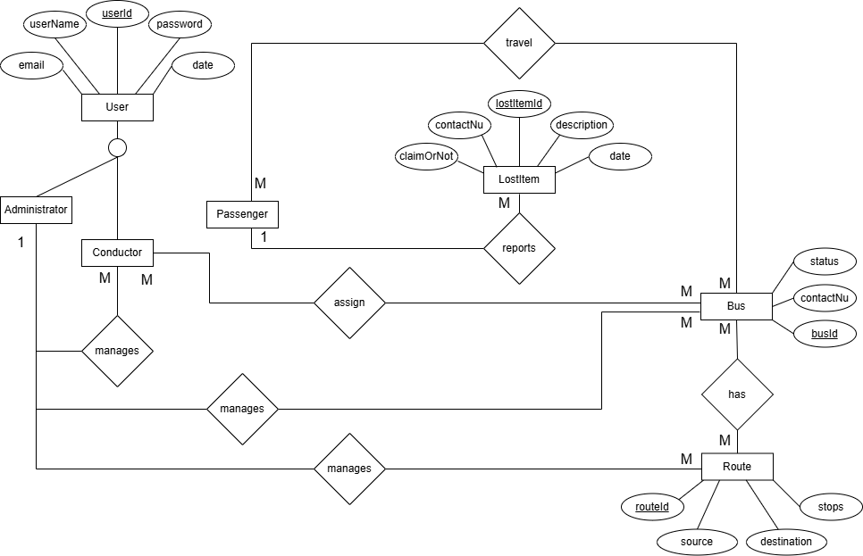
System Design
ER Diagram
Notes:
We’ve put a lot of thought into the design of TrackNGo. Here’s a quick overview:
ER Diagram: This shows relationships between different entities like users, buses, and routes.

Slide 14
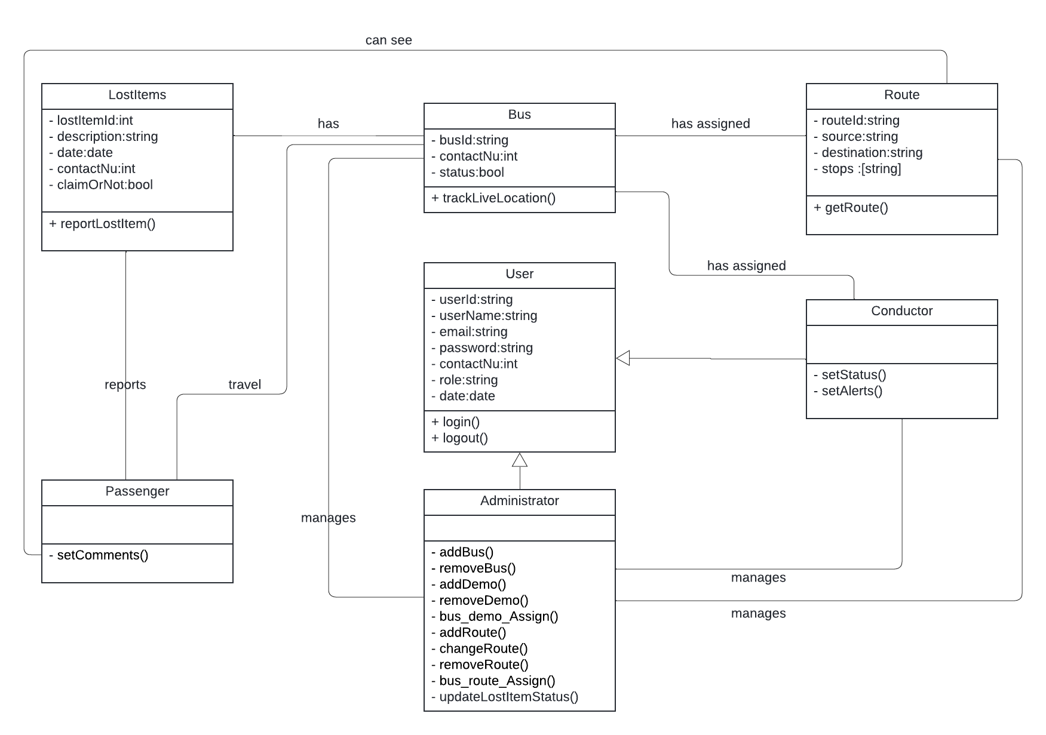
System Design
UML Class Diagram
Notes:
UML Class Diagram: Details how system components interact with each other.

Slide 15
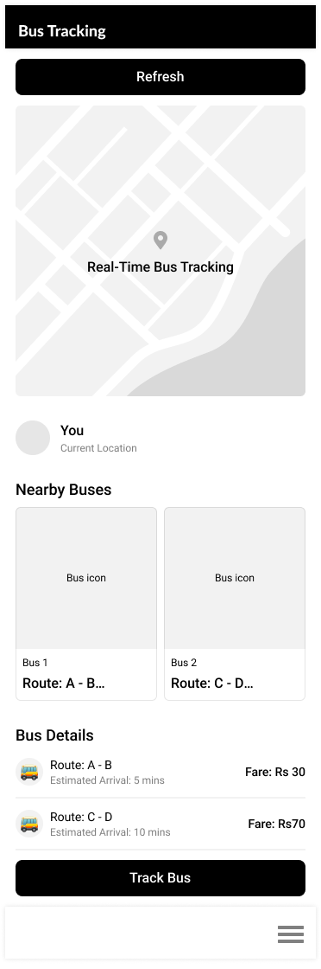
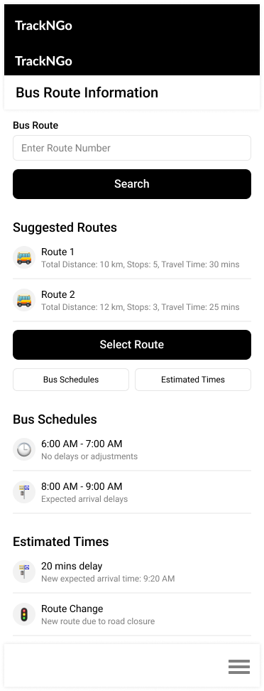
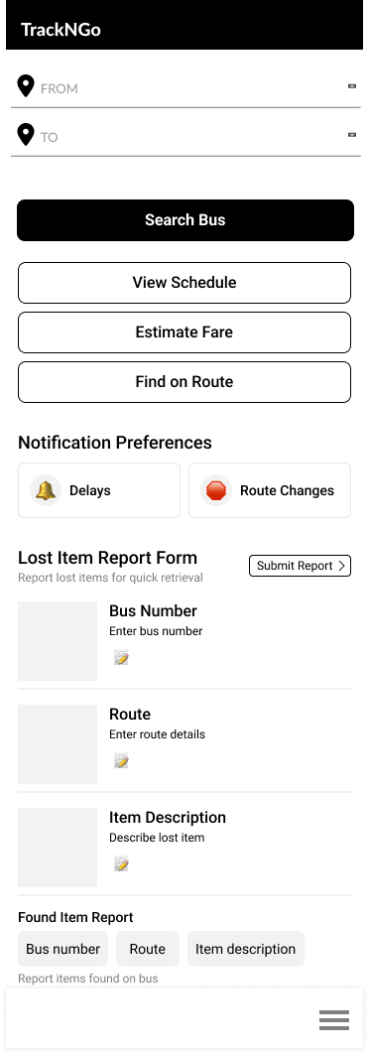
System Design
BUS TRACKING PAGE
BUS ROUTE INFO PAGE
HOME PAGE
WireFrame
Design
Notes:
Wireframes: Here are some sample screens:
Home Page: A landing page where users can access various features.
Bus Tracking Page: Shows real-time bus locations.
Bus Route Info Page: Provides route details and estimated travel time.
Fare Estimation Page: Helps users calculate approximate fares.
Lost and Found Page: Makes it easy to report lost items.
Conductor Login: A separate login area for bus conductors."

Slide 16
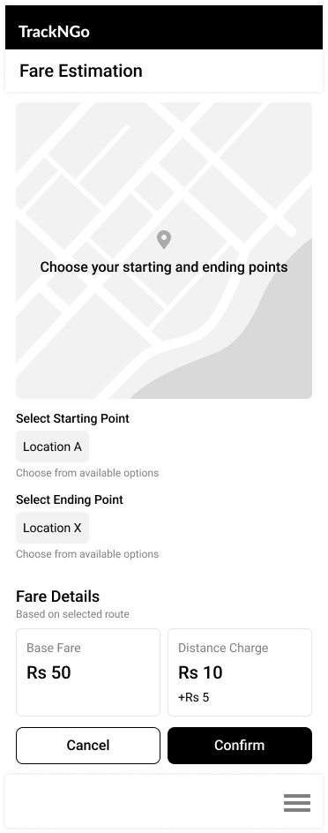
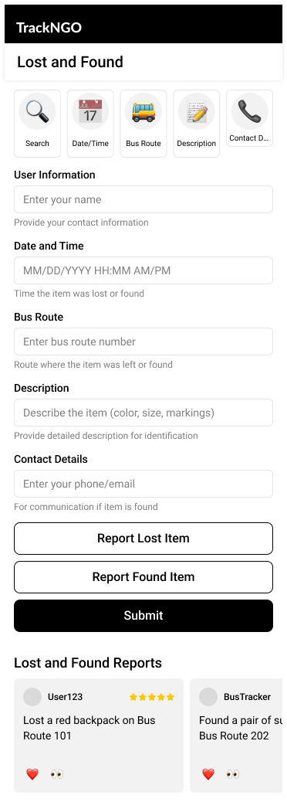
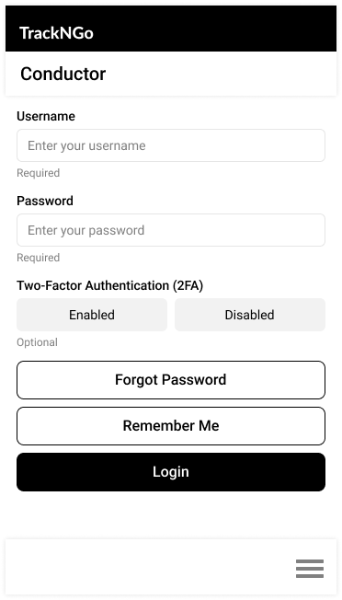
System Design
FARE ESTIMATION PAGE
LOST AND FOUND PAGE
CONDUCTOR LOGIN
WireFrame
Design
https://www.figma.com/design/0b42cfG9fQWQlKmkJcJCY7/TrackNGo_UI?node-id=0-1&t=rygB5ks4WCix7QyL-1
Notes:
Wireframes: Here are some sample screens:
Home Page: A landing page where users can access various features.
Bus Tracking Page: Shows real-time bus locations.
Bus Route Info Page: Provides route details and estimated travel time.
Fare Estimation Page: Helps users calculate approximate fares.
Lost and Found Page: Makes it easy to report lost items.
Conductor Login: A separate login area for bus conductors."

Slide 17

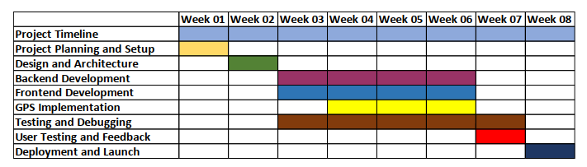
Implementation Plan
Notes:
Our implementation plan includes several stages: development, testing, and deployment.
Each stage was planned carefully to ensure that all features are functional and user-friendly.
Testing helped us fix bugs and ensure the app provides a smooth experience

Slide 18
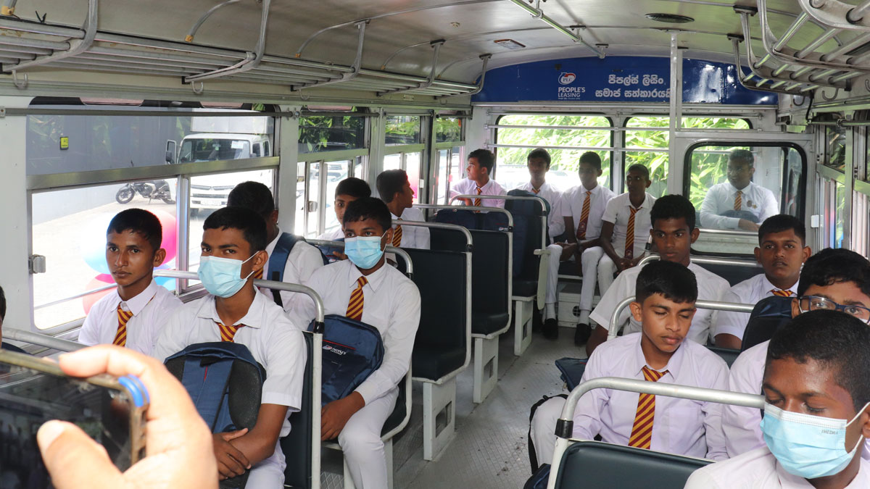


Conclusion
TrackNGo addresses key transit challenges with GPS tracking and real-time planning. By offering live bus locations, optimized routes, and timely notifications, it aims to improve commuter satisfaction and build a more efficient, reliable public transport system in Sri Lanka.
Notes:
In conclusion, TrackNGo tackles the key challenges in Sri Lanka’s public transport system through GPS tracking, real-time planning, and updated notifications.
We believe this app has the potential to significantly improve commuting experiences, offering a more reliable, efficient, and enjoyable way to travel."

Slide 19
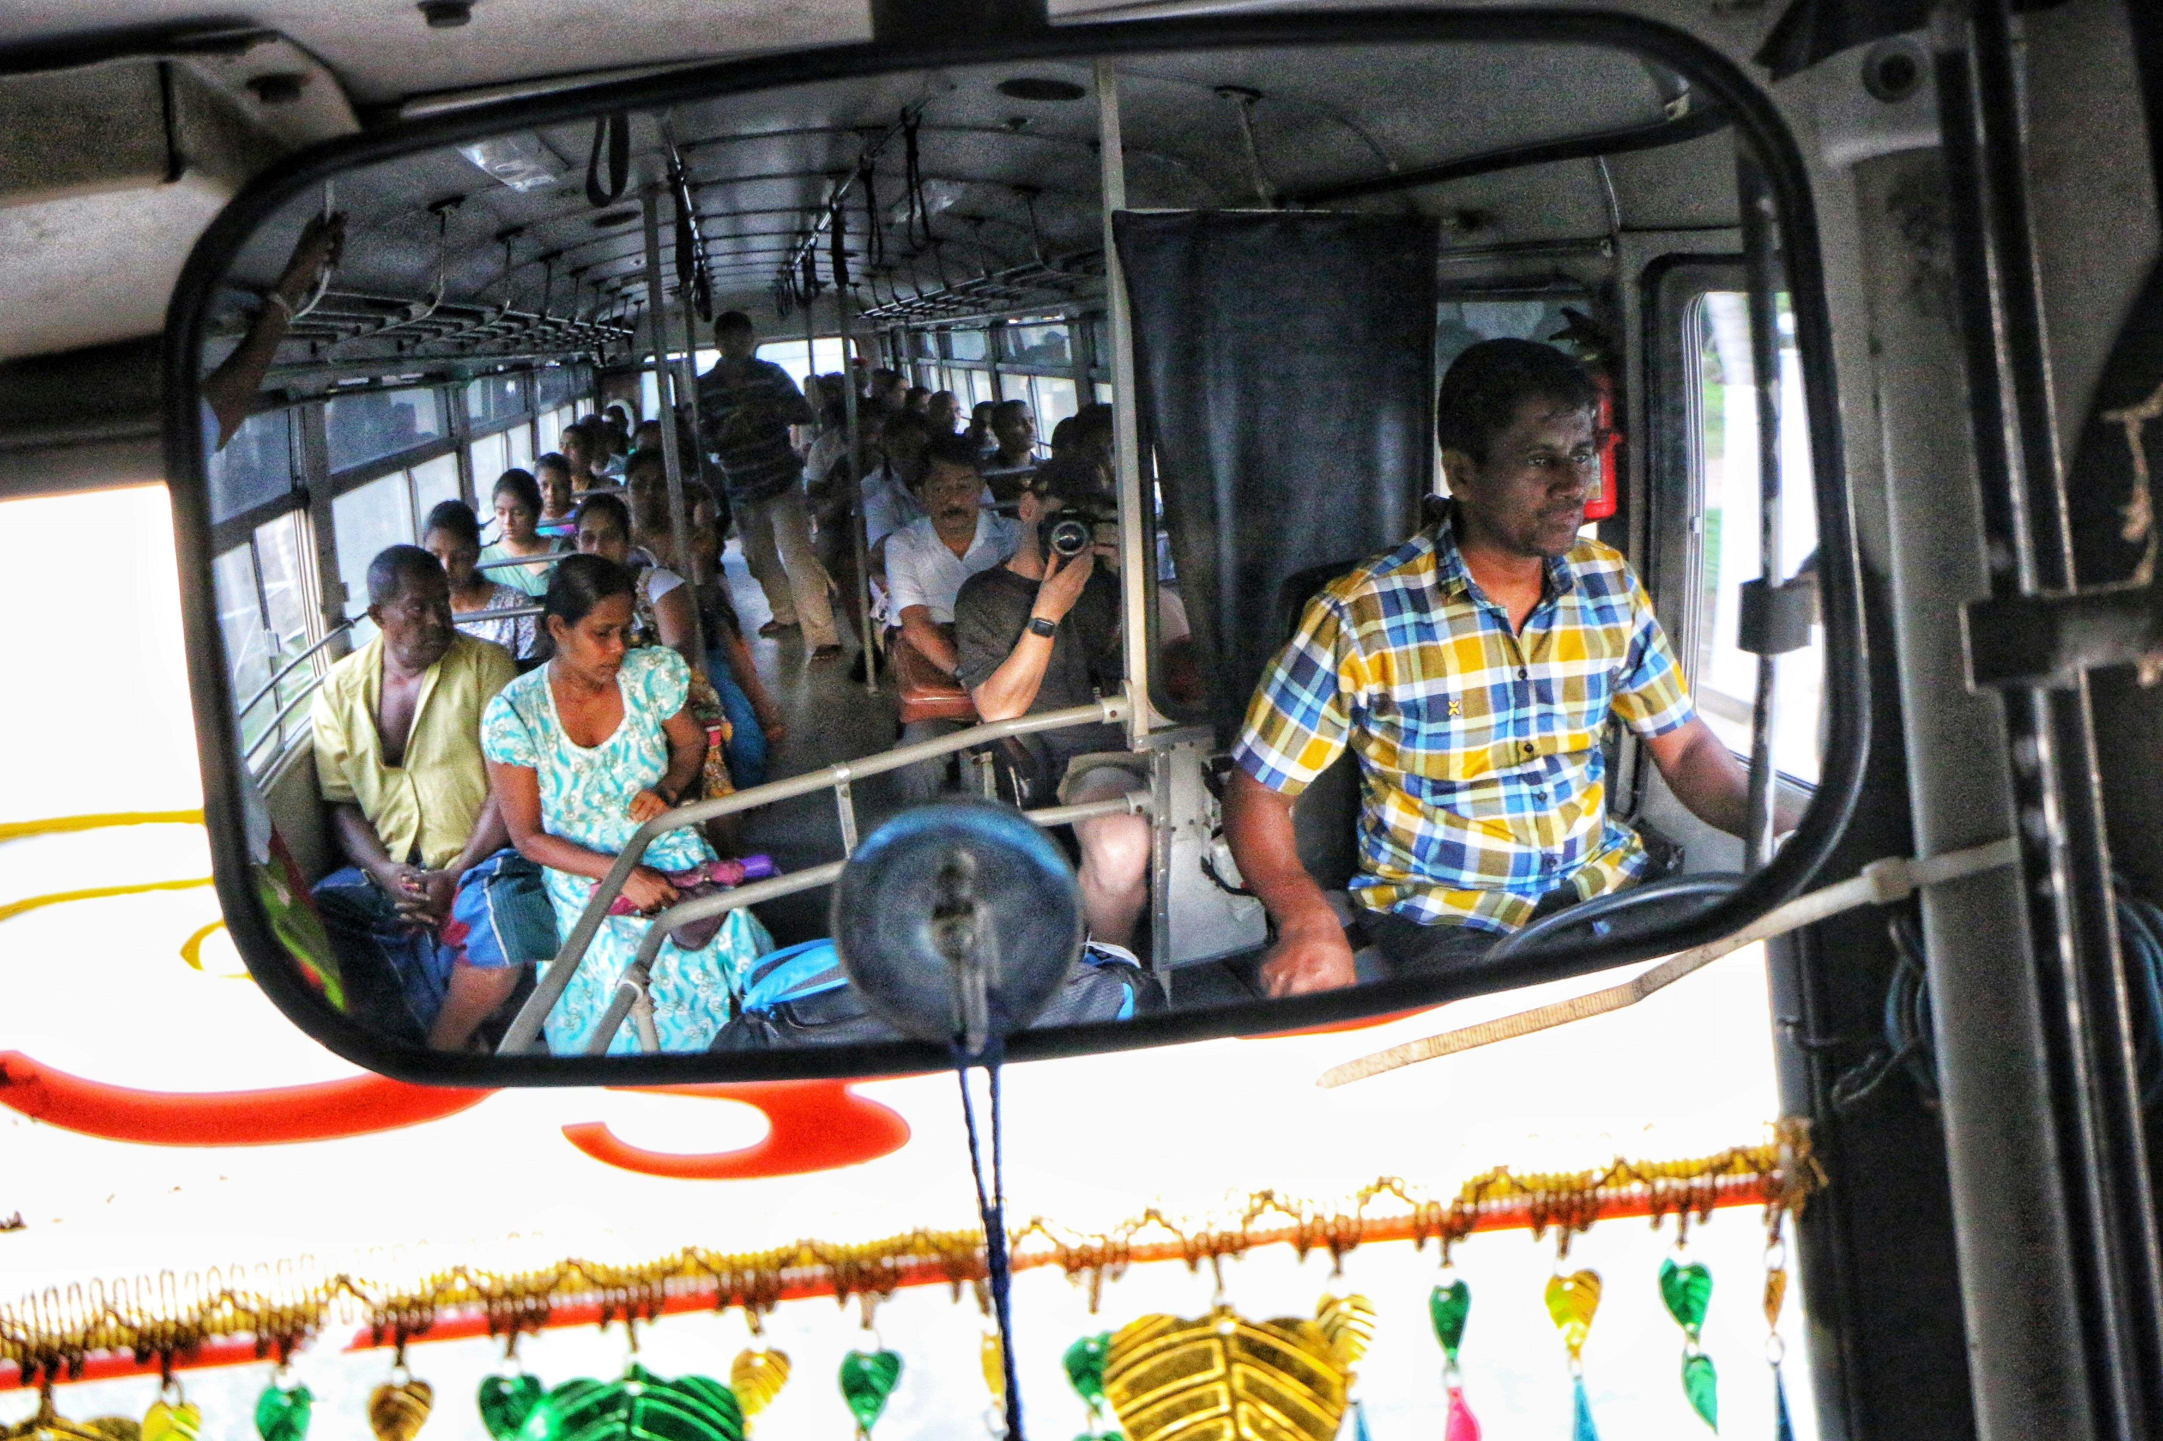
Group Details
2020/ICT/07 - Mr. Nalawansa U.K
2020/ICT/49 - Mr. Bandara R.M.M.T.
2020/ICT/32 - Mr. Kalhara K.A.T.
2020/ICT/23 - Mr. Naveen P.R.
2020/ICT/118 - Ms.M.T.F.Shazna
2020/ICT/36 - Ms. Dhanapala D.M.C.S.
2020/ICT/88 - Ms. Perera KNR
Notes:
Finally, here are the team members who contributed to TrackNGo’s development. Thank you for your attention, and we’re open to any questions."

Slide 20
Thank You
Notes:
Thank you once again for listening to our presentation. We hope TrackNGo can be a valuable asset to improve public transportation in Sri L
Thank you for your time and attention! We hope you enjoyed learning about TrackNGo, and we’re happy to answer any questions you might have."anka.

